Slide 1
Bilkent University CS 319 Object-Oriented Software Engineering Summer 2017 Project Name: Hotel Reservation System Group #1 Mehmet Ali Altuntaş 21401004 Damla Eda Bıçakcı 21402130 Murat Süerdem 21401107 İrem Yurdakul 21400299

Slide 2
Purpose of the system
Main advantages of the system is choosing features of the room while making reservation. If customer choose just to stay in the room with basic form of it, customer pay less and customer does not have to choose fixed features, customer can decide which feature is important for him like laundry, breakfast or tv.

Slide 3
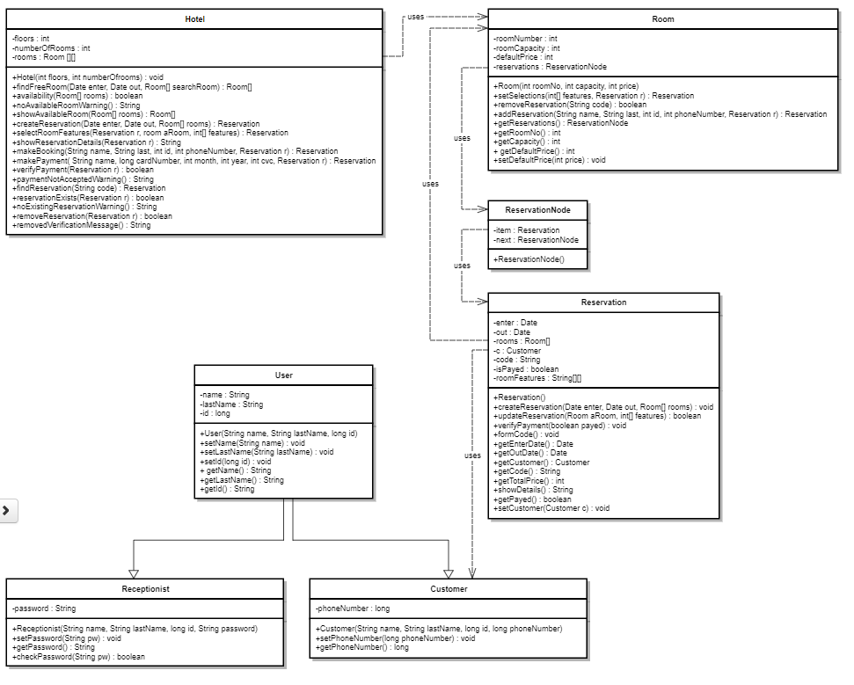

Slide 4
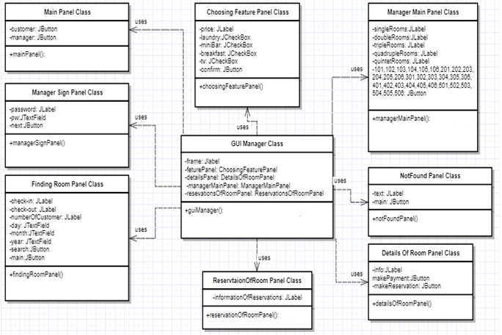

Slide 5
